Slide 1
Chapter 20
Data Recovery Advisor

Slide 2
Background on EMT Analogy
Editor for the RMAN Recipes book is a volunteer EMT
Shared ideas on EMT vs. Paramedic
EMT has less training/experience
Paramedic has more training/experience
Paramedic can override defibrillator
Authors thought analogy applied well to Data Recovery Advisor

Slide 3
Data Recovery Advisor
New with Oracle Database 11g
Provides advice on what media failures have occurred and how to resolve them
Can be accessed from RMAN command line or from Enterprise Manager screens

Slide 4
RMAN command line
RMAN> list failure;
RMAN> advise failure;
RMAN> repair failure;

Slide 5
List Failure
RMAN> list failure
Uses Automatic Diagnostic Repository
V$DIAG_INFO view
Validate database to verify failures
RMAN> validate database;

Slide 6
Advise Failure
RMAN> list failure;
RMAN> advise failure;
Manual repair instructions
Automated repair instructions
  Option
  Strategy
  Repair description
  Repair script

Slide 7
Repairing Failures
Recommended sequence:
RMAN> list failure;
RMAN> advise failure;
RMAN repair failure;

Slide 8
Repairing Failures
Logging output
RMAN> spool log to rep.txt
Previewing repair
RMAN> repair failure preview;
Repairing failure
RMAN> repair failure noprompt;

Slide 9
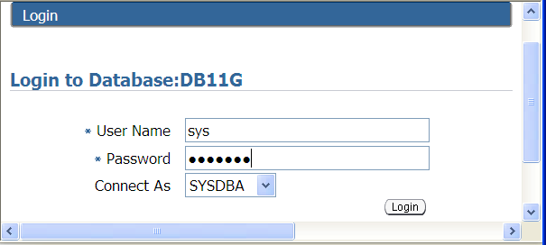
Data Recovery Advisor and Enterprise Manager
Logon to Enterprise Manager with a sysdba schema

Slide 10
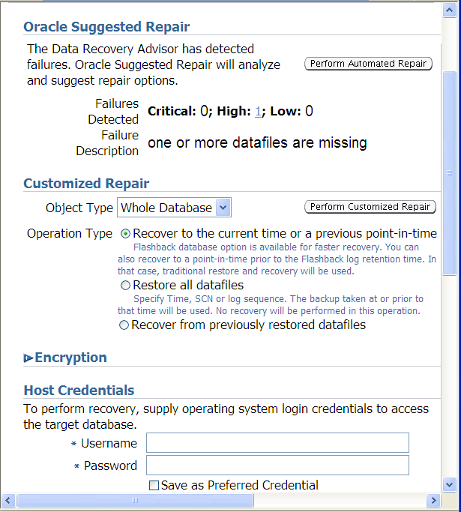
Data Recovery Advisor
Navigate to Perform Recovery
Enter host credentials

Slide 11
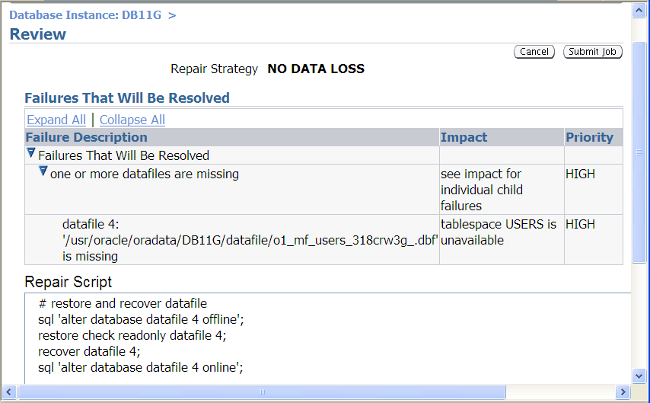
Data Recovery Advisor
View RMAN commands

